Slide 1
UNIT 1 : Boolean Algebra

Slide 2
Boolean Operations and Expressions

Slide 3
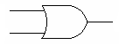
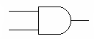
Boolean Operations and Expressions
Addition
0 + 0 = 0
0 + 1 = 1
1 + 0 = 1
1 + 1 = 1
Multiplication
0 * 0 = 0
0 * 1 = 0
1 * 0 = 0
1 * 1 = 1

Slide 4
Laws and Rules of Boolean Algebra

Slide 5
Laws Boolean Algebra
Commutative Laws
Associative Laws
Distributive Law

Slide 6
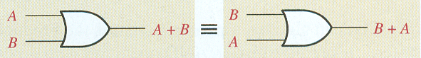
Laws of Boolean Algebra
Commutative Law of Addition:
A + B = B + A

Slide 7
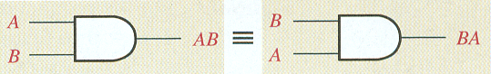
Laws of Boolean Algebra
Commutative Law of Multiplication:
A * B = B * A

Slide 8
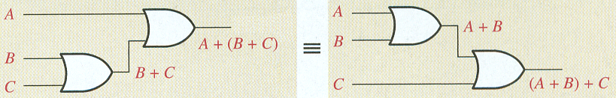
Laws of Boolean Algebra
Associative Law of Addition:
A + (B + C) = (A + B) + C

Slide 9
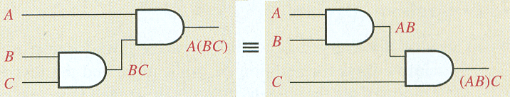
Laws of Boolean Algebra
Associative Law of Multiplication:
A * (B * C) = (A * B) * C

Slide 10
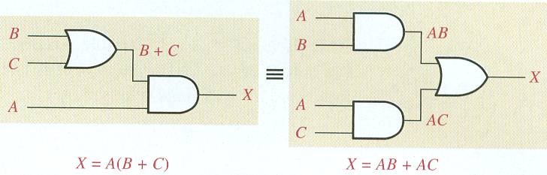
Laws of Boolean Algebra
Distributive Law:
A(B + C) = AB + AC

Slide 11
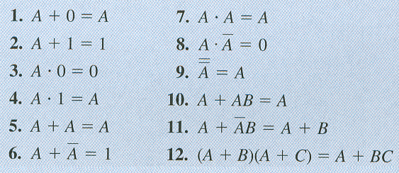
Rules of Boolean Algebra

Slide 12
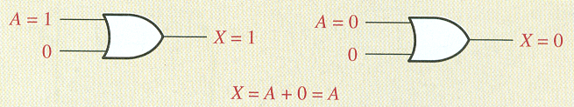
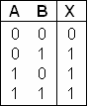
Rules of Boolean Algebra
Rule 1
OR Truth Table

Slide 13
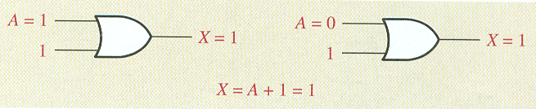
Rules of Boolean Algebra
Rule 2
OR Truth Table

Slide 14
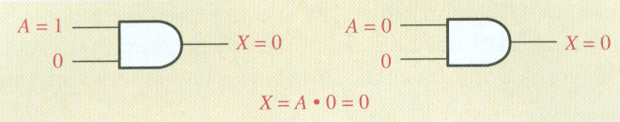
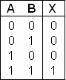
Rules of Boolean Algebra
Rule 3
AND Truth Table

Slide 15
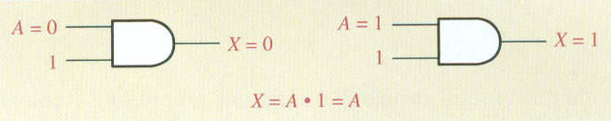
Rules of Boolean Algebra
Rule 4
AND Truth Table

Slide 16
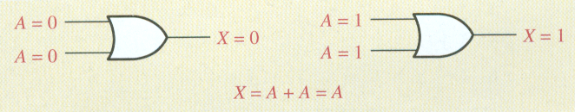
Rules of Boolean Algebra
Rule 5
OR Truth Table

Slide 17
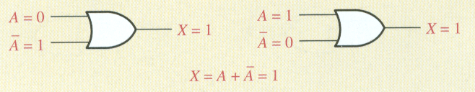
Rules of Boolean Algebra
Rule 6
OR Truth Table

Slide 18
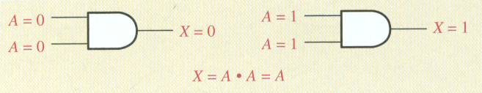
Rules of Boolean Algebra
Rule 7
AND Truth Table

Slide 19
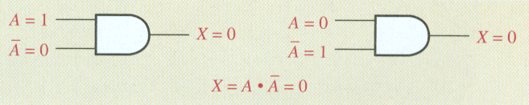
Rules of Boolean Algebra
Rule 8
AND Truth Table

Slide 20
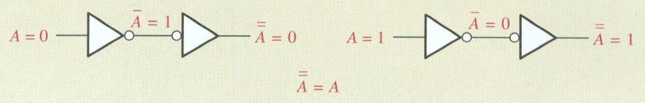
Rules of Boolean Algebra
Rule 9

Slide 21
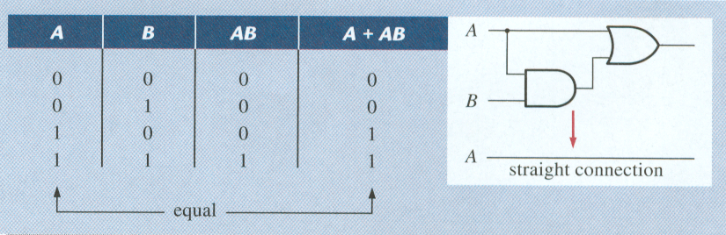
Rules of Boolean Algebra
Rule 10: A + AB = A
AND Truth Table
OR Truth Table

Slide 22
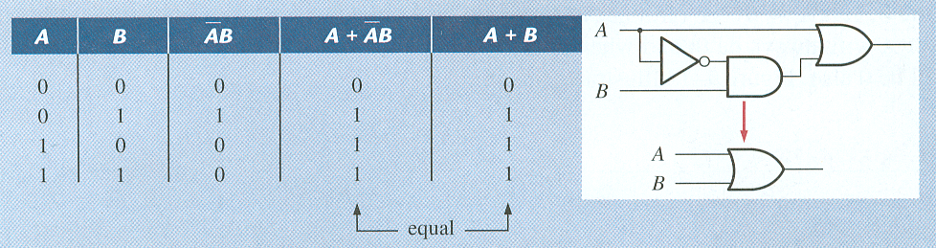
Rules of Boolean Algebra
Rule 11:
AND Truth Table
OR Truth Table

Slide 23
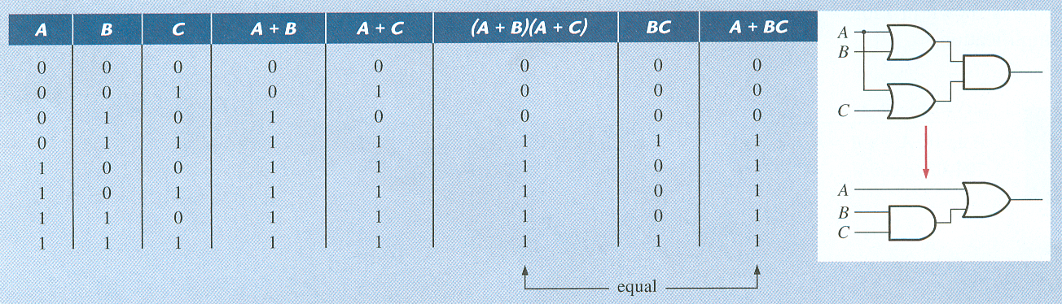
Rules of Boolean Algebra
Rule 12: (A + B)(A + C) = A + BC
AND Truth Table
OR Truth Table

Slide 24
DeMorgan’s Theorem

Slide 25
DeMorgan’s Theorems
Theorem 1
Theorem 2
Remember:
“Break the bar, change the sign”

Slide 26
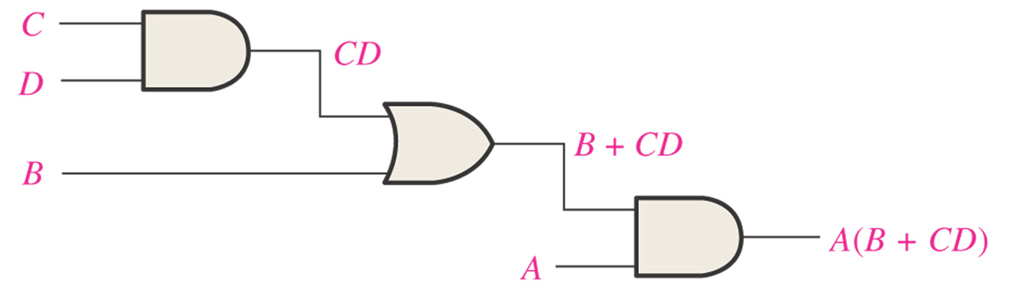
Figure 4–16 A logic circuit showing the development of the Boolean expression for the output.

Slide 27
Figure 4–16 A logic circuit showing the development of the Boolean expression for the output.

Slide 28
Standard Forms of Boolean Expressions

Slide 29
Standard Forms of Boolean Expressions
The sum-of-product (SOP) form
Example: X = AB + CD + EF
The product of sum (POS) form
Example: X = (A + B)(C + D)(E + F)

Slide 30
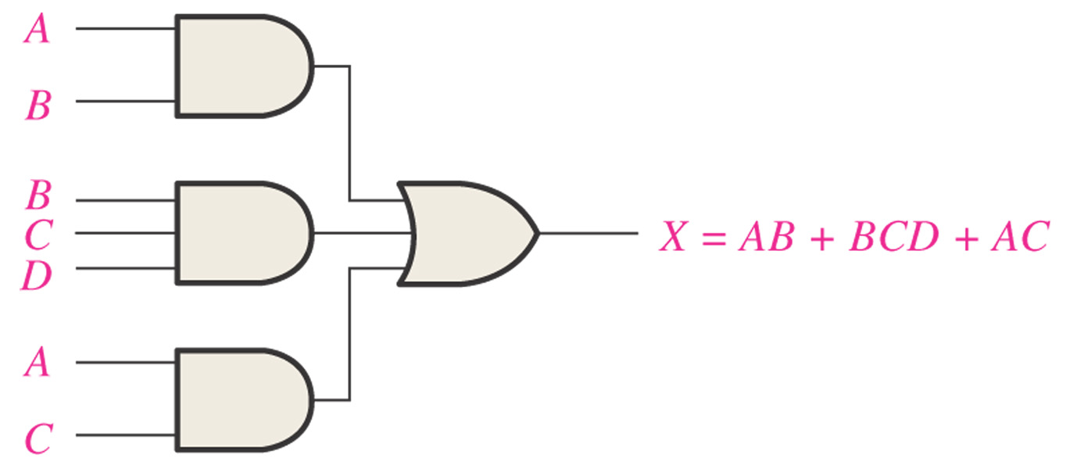
Figure 4–18 Implementation of the SOP expression AB + BCD + AC.

Slide 31
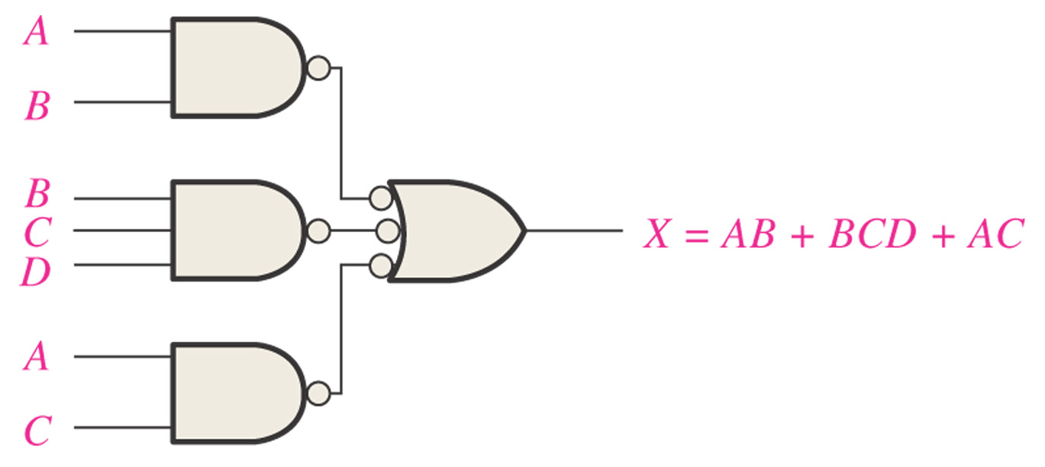
Figure 4–19 This NAND/NAND implementation is equivalent to the AND/OR in Figure 4–18.

Slide 32
Figure 4–19 This NAND/NAND implementation is equivalent to the AND/OR in Figure 4–18.

Slide 33
The Karnaugh Map

Slide 34
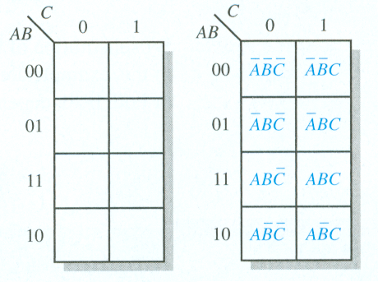
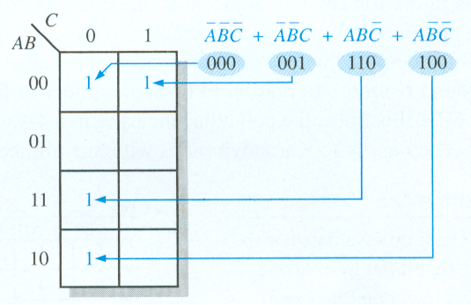
The Karnaugh Map
3-Variable Karnaugh Map
3-Variable Example

Slide 35
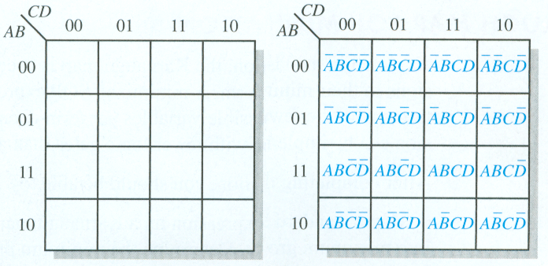
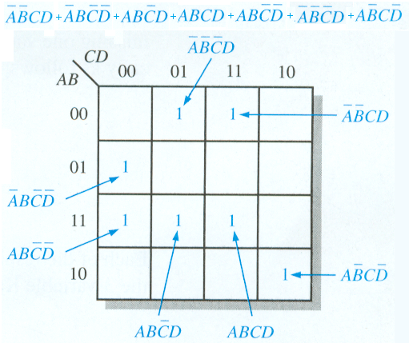
The Karnaugh Map
4-Variable Karnaugh Map
4-Variable Example

Slide 36
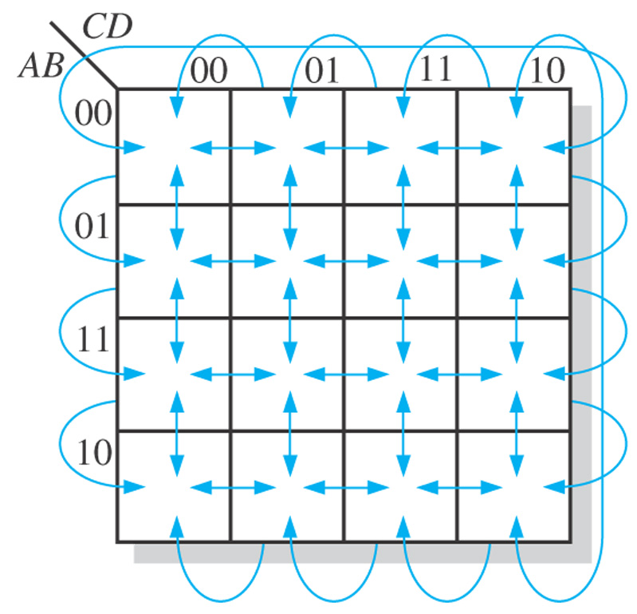
Figure 4–23 Adjacent cells on a Karnaugh map are those that differ by only one variable. Arrows point between adjacent cells.

Slide 37
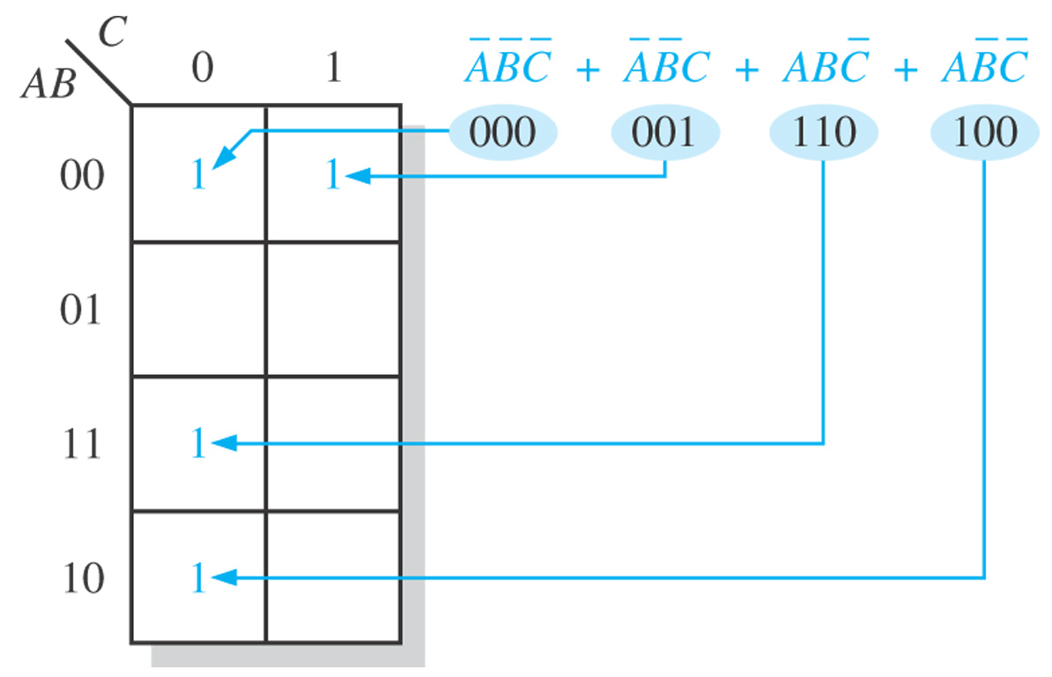
Figure 4–24 Example of mapping a standard SOP expression.

Slide 38
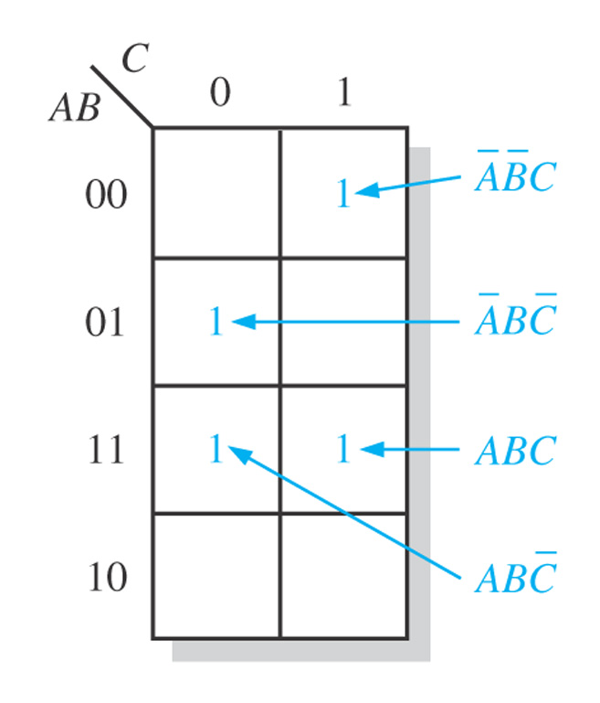
Figure 4–25

Slide 39
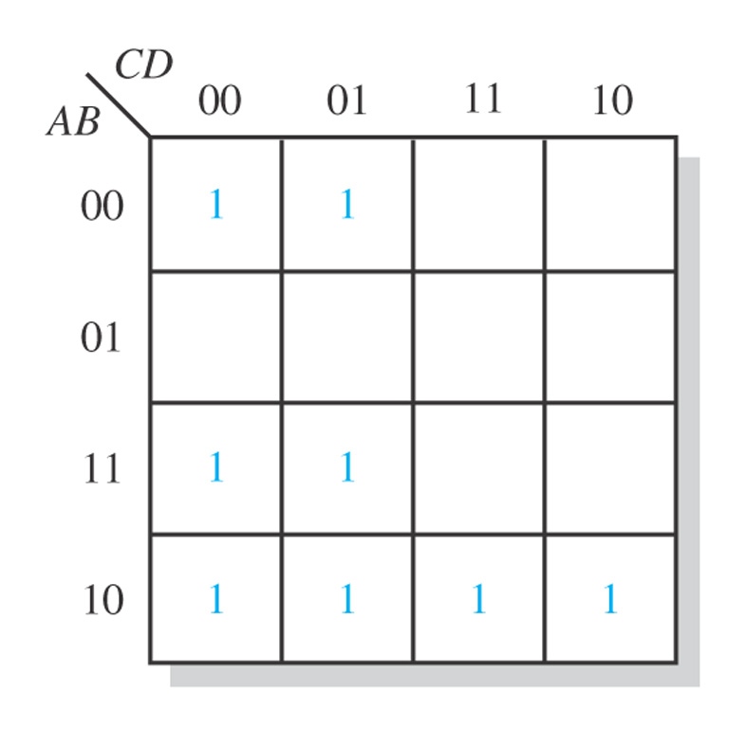
Figure 4–28

Slide 40
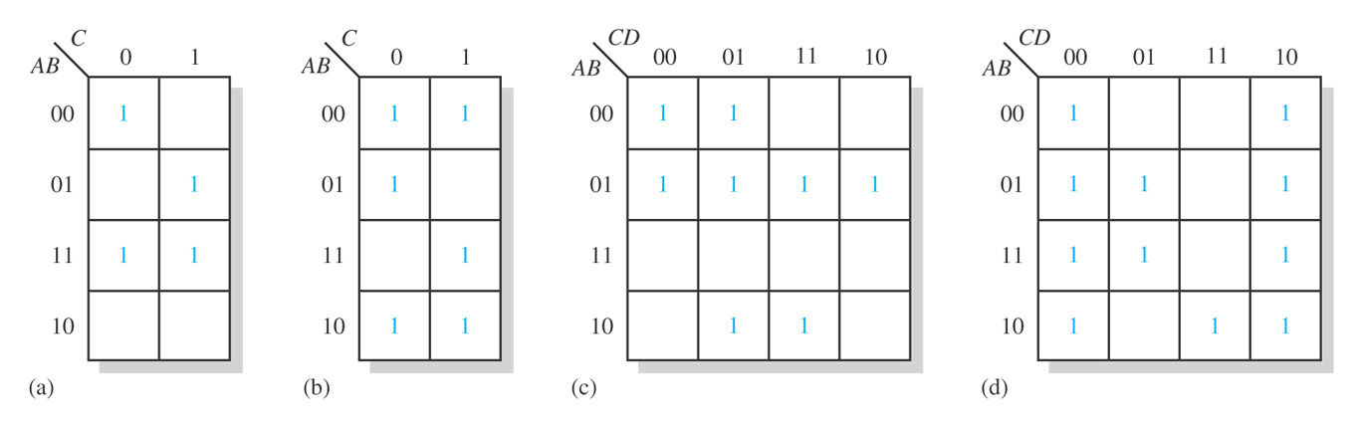
Figure 4–29

Slide 41
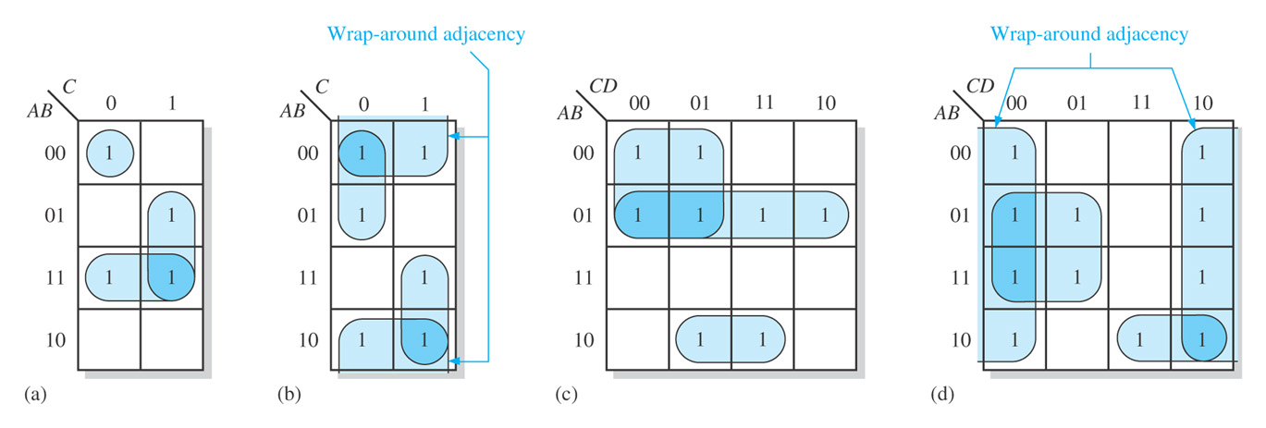
Figure 4–30

Slide 42
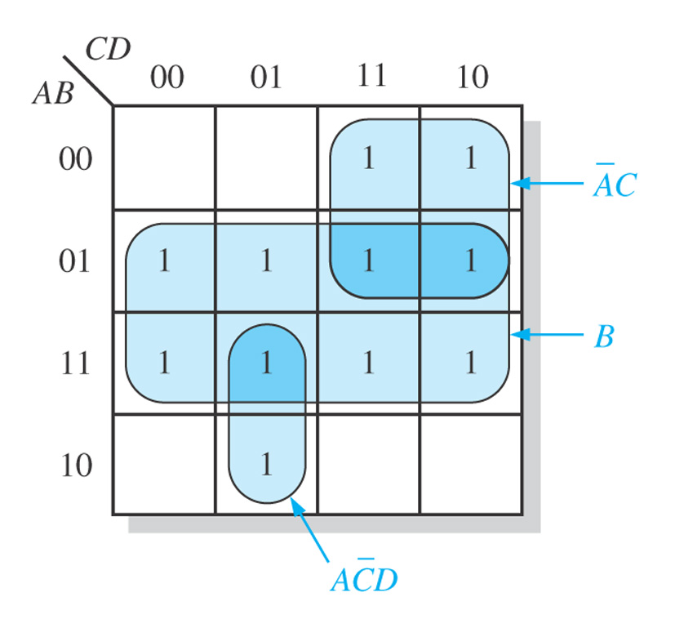
Figure 4–31

Slide 43
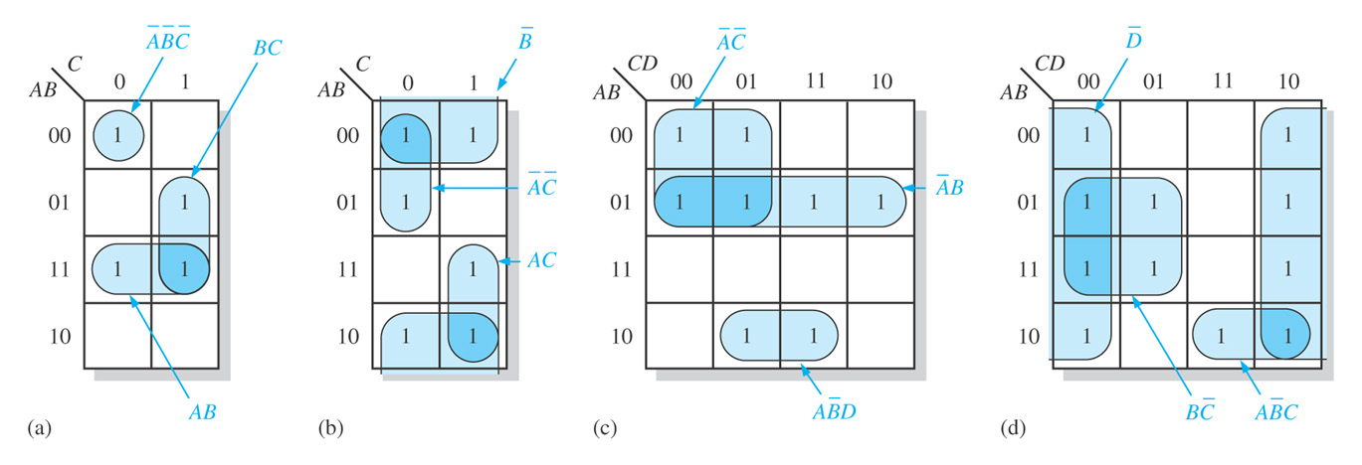
Figure 4–32

Slide 44
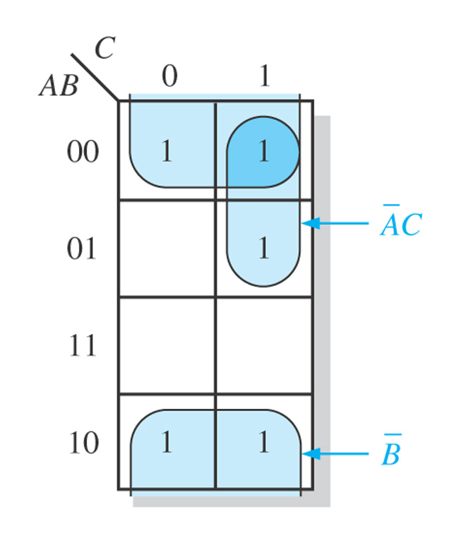
Figure 4–33

Slide 45
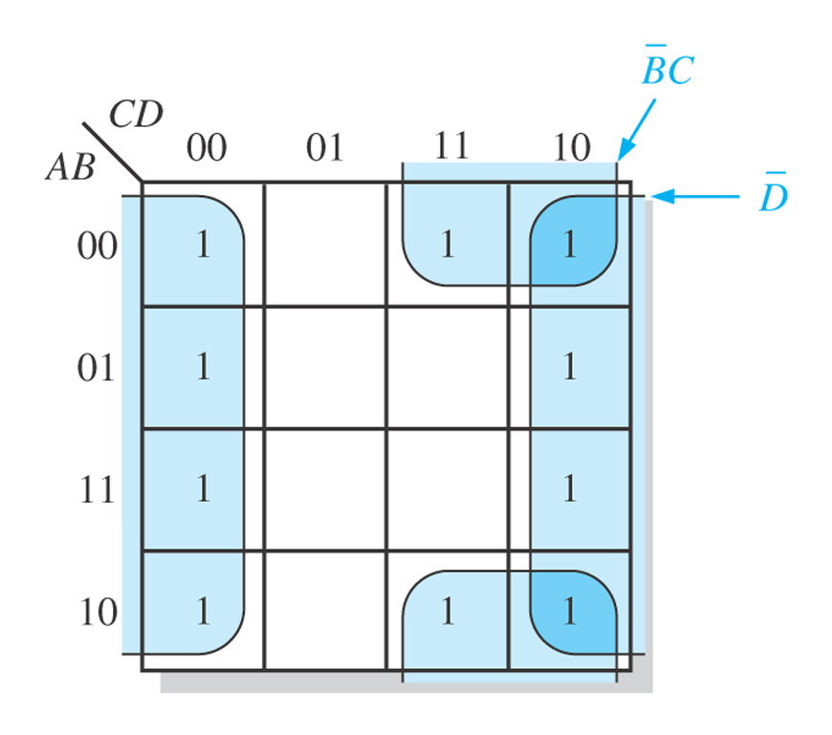
Figure 4–34

Slide 46
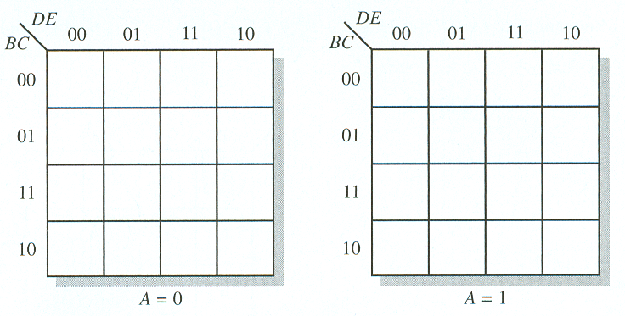
The Karnaugh Map
5-Variable Karnaugh Mapping

Slide 47
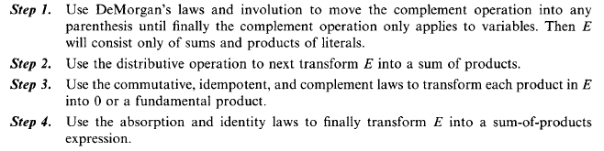
SUM-OF-PRODUCTS FORM FOR BOOLEAN ALGEBRAS
Below is the four-step algorithm which uses the Boolean algebra laws to transform any Boolean expression into an equivalent sum-of-products expression.

Slide 48
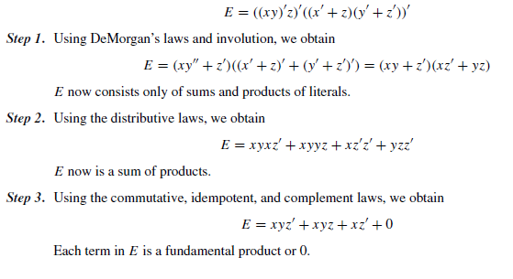
EXAMPLE

Slide 49
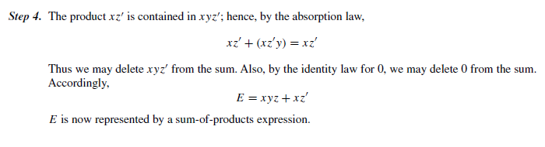

Slide 50
The sum-of-products form for a Boolean expression E is also called the disjunctive normal form or DNF of E.
The complete sum-of-products form for E is also called the full disjunctive normal form, or the disjunctive canonical form, or the minterm canonical form of E.

Slide 51
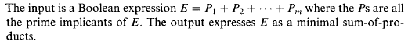
Finding a Minimal Sum-of-Products Form

Slide 52
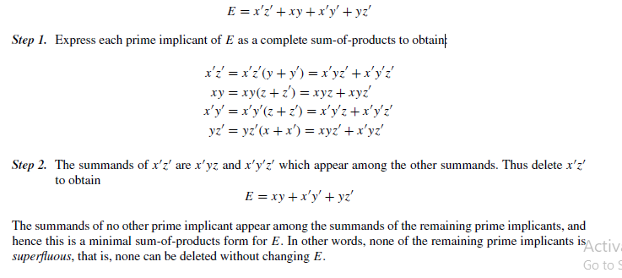
Example

